Slide 1

EDA
Shikha Gupta, PhD

Slide 2
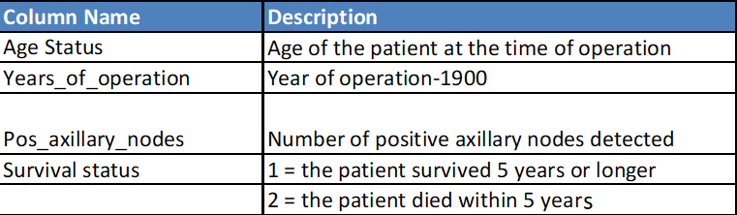
Data – Background and Description
The dataset contains cases from a study that was conducted between 1958 and 1970 at the University of Chicago's Billings Hospital on the survival of patients who had undergone surgery for breast cancer.
The dataset comprises of 306 observations of 4 columns

Slide 3

EDA
Analysis Based
on
Number of
Positive Axillary Nodes

Slide 4
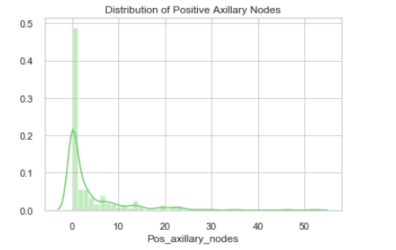
Distribution of Positive Axillary Nodes in Breast Cancer Patients
136 out of 306 patients had zero positive axillary nodes, 94 patients had 1-5 and 76 patients had more than 5 positive axillary nodes .

Slide 5
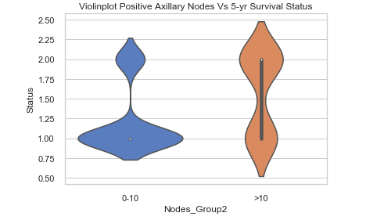
5-year Survival Status of Patients with <10 and >10 Positive Axillary Nodes
57% of the patients with more than 10 positive axillary nodes did not survive beyond 5 years which is 2.5 times the death rate of patients with less than 10 positive axillary nodes (22%)

Slide 6
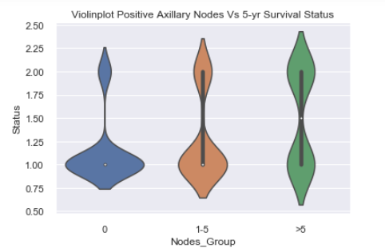
5-year Survival Status of Patients with 0, 1-5 or >5 Positive Axillary Nodes
5-year survival rate was highest (86%) in patients with zero positive axillary nodes, followed by patients with 1-5 axillary nodes (73%) and lowest in patients with >5 positive axillary nodes (50%)

Slide 7
EDA
Analysis Based
on
Age of Patients

Slide 8
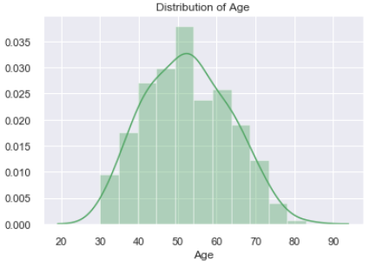
Distribution of Age in Breast Cancer Patients
43 out of 306 patients were 30-40 years old (Young). Out of the remaining 263 patients who were above 40 years, 147 patients were in the age group of 41-55 years (Middle Age) and 116 patients were >55 years old (Old).

Slide 9
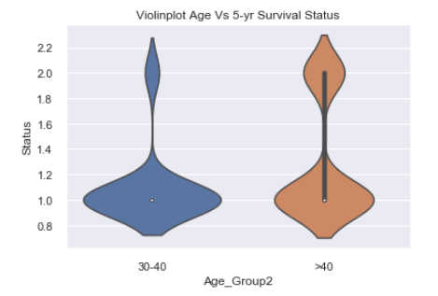
5-year Survival Status of Patients above and below 40 years
5-year survival rate in patients below 40 years (91%) was 20% higher than the Older patients (71%).

Slide 10
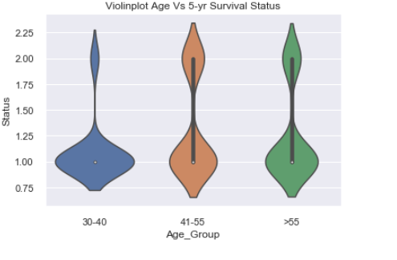
5-year Survival Status of Young, Middle Age and Old Patients
5-year survival rate was highest (91%) in Young patients, followed by Older patients(74%) and lowest in Middle Aged population (68%)

Slide 11
EDA
Analysis Based
on
Years of Operation

Slide 12
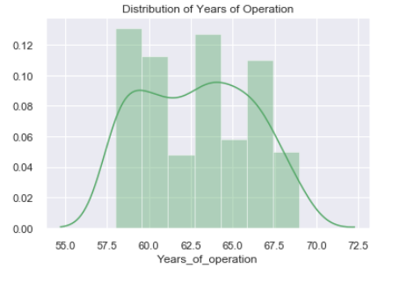
Distribution of Years of Operation in Breast Cancer Patients
Patients in this data set were operated between 1958 to 1969. ~50% (140) operations were done before 1963 and the remaining(166) were done in or after 1963.

Slide 13
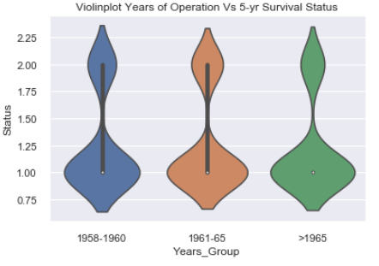
5-year Survival Status based on Years of Operation
There is no visible difference in the 5-year survival rate of patients in different groups based on Years of operation (1958-60, 1961-65, >1965). However, there is a 6% increase in survival rate of patients who were operated after 1965 (78%) as compared to the group operated in1958-1960 (72%).

Slide 14
EDA
Analysing the data for any
bias in different groups

Slide 15
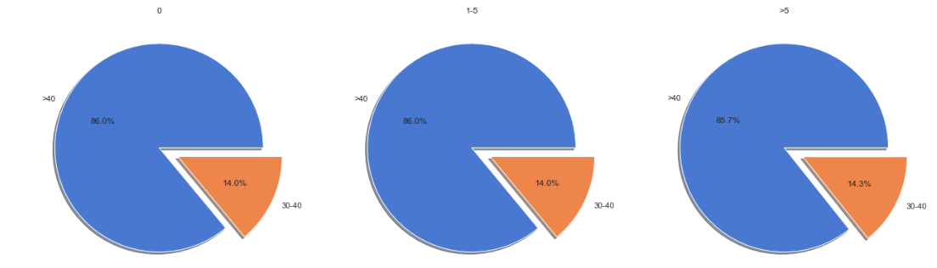
Age Distribution in Patients with 0, 1-5, >5 Positive Axillary Nodes
Three different node groups had a similar % of old and young population, hence a higher 5-year survival rate in the patient group with ‘zero positive axillary nodes’ is not because of any bias in the distribution of younger population in this group

Slide 16
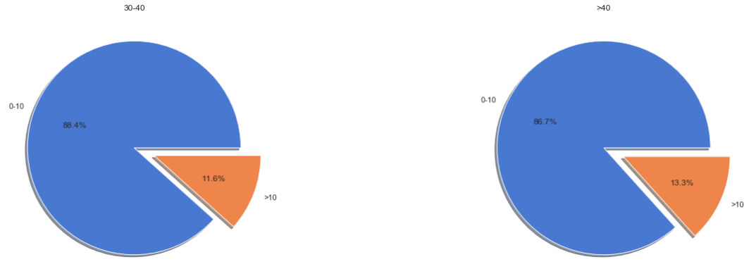
Positive Axillary Node Distribution in patients below and above 40 years
Young group (30-40 years) had ~12% patients with >10 positive axillary nodes, which was similar to the group of patients above 40 years (13%). Hence ~20% higher 5-year survival rate in the Young group of patients, was not because of any bias in the distribution of patients with <10 positive axillary nodes in this group

Slide 17
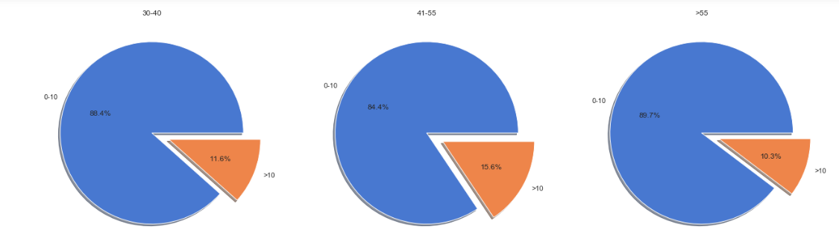
Positive Axillary Node Distribution in Young, Middle Aged and Old patients
~6% lower 5-year survival rate in Middle Aged patients(41-55) as compared to Old patients (>55years) is most likely due to a ~6% higher number of patients with >10 positive axillary nodes in the Middle Aged group (16%) as compared to the Old group (10%) of patients.

Slide 18
EDA
Analysis Based
on
Pair Plot

Slide 19
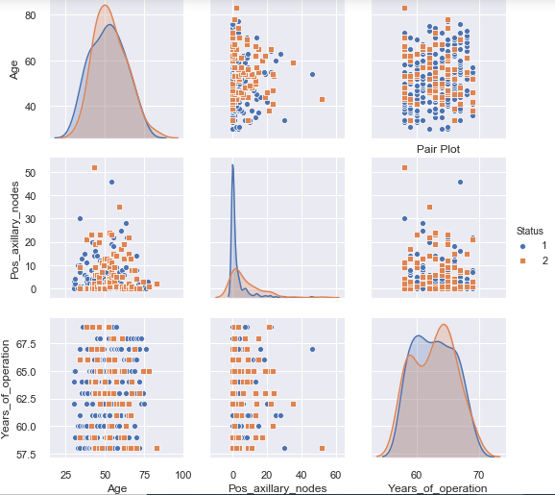
Pair Plot –Slide 1

Slide 20
EDA
Re-Analysis Based
on
Pair Plot

Slide 21
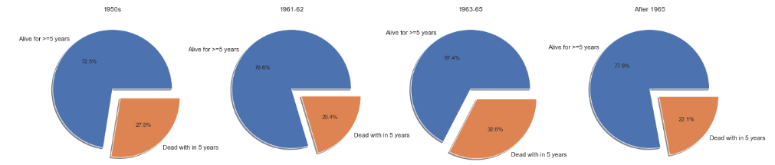
5-year Survival Status of Patients operated in 1958-1960, 1961-62, 1963-65, >1965
Patients who were operated between 1963-65 had 10-12% less survival rate (68%) beyond 5 years as compared to the patients who were operated in 1961-62 (80%) and after 1965 (78%)

Slide 22
EDA
Cause of Lower 5-year Survival Rate
in
Patients Operated
from
1963 to 1965

Slide 23
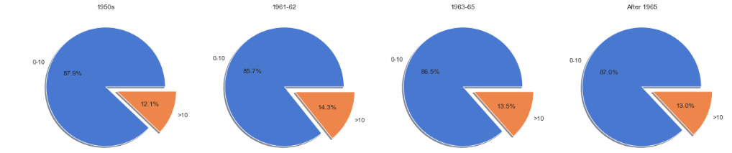
Distribution of Positive Axillary Nodes in Patients Operated in 1958-60, 1961-62,1963-65 and >1965
The patients operated between 1963-65 had a similar number of patients with >10 positive axillary nodes (13.5%) as compared to the patients operated between 1958-1960 (12%), 1961-62 (14%) or after 1965 (13%). Hence, number of positive axillary nodes does not explain higher 5-year death rate in this group of patients.

Slide 24
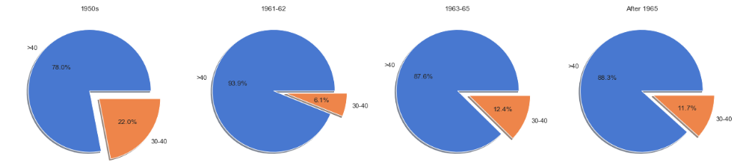
Distribution of Age in Patients Operated in 1958-60, 1961-62,1963-65 and >1965
The patients operated between 1963-65 had a similar distribution of young (12%) and old patients as compared to the patients operated after1965 (12% young). Hence age does not explain a lower 5-year survival rate in this group of patients
Interestingly, patients operated between 1958-1960, had a higher % of young(30-40years) population (22%) and slightly less number of patients with >10 positive axillary nodes (12%), but still had a higher 5-year death rate (27%) as compared to the population that was operated upon in 1961-62 (20%) as well as those who were operated after 1965 (22%)

Slide 25
EDA
Conclusions
and
Actionable Insights

Slide 26
Conclusions: Slide 1
Number of positive axillary nodes is the strongest factor that affect the 5-year survival of breast cancer patients (Pearson Co-efficient for correlation = 0.3). Age is the second most important factor that affect the 5-year survival of breast cancer patients (Pearson Co-efficient for correlation = 0.07).
The higher 5-year survival rate (86%) in the patient group with zero positive axillary nodes was not because of a skewed distribution of younger patients in that group but most likely because of complete removal of cancer cells before the spread of the disease.
The higher 5-year survival rate in young group of patients (30-40) was not because of any skewed distribution of patients with <10 positive axillary nodes in that group but was most likely due to a stronger and younger immune system and hence stronger ability to fight and kill cancer cells.

Slide 27
Conclusions: Slide 2
There was an increase in the 5-year survival rate in the patients operated after 1960 as compared to the patients operated before 1960 with 1963-65 being an exception
This improvement was most likely due to advancement in medical technology and better surgical techniques.
There was an increase in the 5-year death rate in the patients operated between 1963-65 - cause not determined in this analysis.

Slide 28
Actionable Insights:
It is critical to detect breast cancer early - before it spreads to the lymph nodes to improve the 5-year survival rate in patients.
There was no decrease in the percentage of patients with >10 positive axillary nodes in the group operated in 1958-1960 versus the group operated upon after 1965, indicating no improvement in early detection from 1958 to 1969:
Increase in the frequency of screening as well as development of more sensitive screening methods to decrease the number of patients with >10 positive axillary nodes is needed to gain an upper hand in this fight.
It would be good to investigate the reasons for higher 5-year death rate in the patients operated in 1963-65, so that the same is not repeated in the future.
It is also required to understand the improvement in 5-year survival rate from 1958 to1960 versus 5-year survival rate after 1965, to narrow down the surgical methods/techniques for technological advancements to help improve the survival rate further.

Slide 29
EDA
Thanks
Shikha Gupta, PhD

